Slide 1
Live Session 01: Project Planning and
Create Project Structure

Slide 2
Project Planning

Slide 3
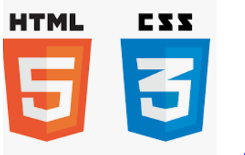


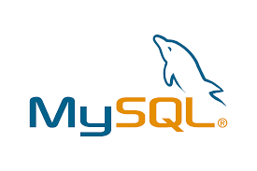

Before we begin, let’s recall what we have covered till now:
Agile
HTML
Git
CSS
MySQL
JavaScript

Slide 4
Agile
It is an iterative approach used to manage the development of a software project.
Git
It is a distributed version control system used to handle software projects.
MySQL
It is a Relational Database Management System used to store data in a structured manner using tables.

Slide 5
HTML and CSS
It is a designed interactive web page.
JavaScript
It is a programming language used in web pages.

Slide 6

Meet Mr. Bob. He is an associate developer working for ZeeCrop.
Notes:
It is a software development company.
It provides end-end development for e-commerce and other similar sites.

Slide 7


Meet Mr. Mark. He is a product owner of the team Bob is a part of.
Hi Bob! I want to increase our product sales. For that, I require a user-friendly web page. Users should be able to find all their requirements on a single page. Can you build that kind of web page for us?
Sure, Mark. I will do that for you.
Notes:
Mr. Mark requests Mr. Bob to design a web page in which user can find all his requirements at one place for easy access.

Slide 8

Now, Mr. Bob thinks about Mr. Mark’s requirements and is puzzled about designing a web page where all the options are available on a single page.
Let me do some research on this.
Notes:
He thinks for a while and begins to search for technologies which can him to build this web page.

Slide 9
He finds the following helpful information to build his web page through his research.
Angular and Node can be used to build front end of the web page.
Spring Boot, Java, and MySQL/MongoDB can be used to build at the back end.
Agile methodology is best for project planning.
Docker and cloud technologies are used to deploy the application.

Slide 10
Bob now plans his activities to create a web page following his research.
Bob decides to do following activities:
Create user stories for Epics of Web App for end user and Admin Dashboard
Plan sprints using JIRA
Create projects using angular framework
Sync projects using GitHub repositories
In this lesson, we will learn how to solve this real-world scenario to help Bob complete his task effectively and quickly.

Slide 11

Explain the various aspects in developing the user stories
Develop user stories for admin dashboard epic and web app for end user epic
Execute stories and plan sprints in JIRA

Slide 12
Execute command using the Angular CLI
Create a Web App Project for end user using Angular CLI
Implement Admin Dashboard Project code using git on GitHub
Implement Web App Project code for end user using git on GitHub

Slide 13
User Stories for Web Admin Dashboard Epic

Slide 14
Admin Dashboard
In this project, various modules will be managed, such as:
Listing the products for end-user
Managing the orders
Managing the users
Notes:
Admin dashboard is our first project. In this project, we will maintain and manage various modules. For eg: listing the products for end-user, managing the users and orders placed by them, etc.

Slide 15

Authentication Story
Admin user should be able to login to the admin dashboard using admin user credentials.
Admin user should perform identification authentication using email and password with captcha verification to access admin site at the backend.
A web page with text fields for username and password with a login button to log in to the system is necessary.
Notes:
Summary: As an admin user, you should be able to login to the admin dashboard
Description: As an admin user, you want to authenticate yourself with email and password with captcha verification to have access to the admin backend.
Acceptance Criteria: A Web page with text fields for username and password with a login button to login to the system.

Slide 16
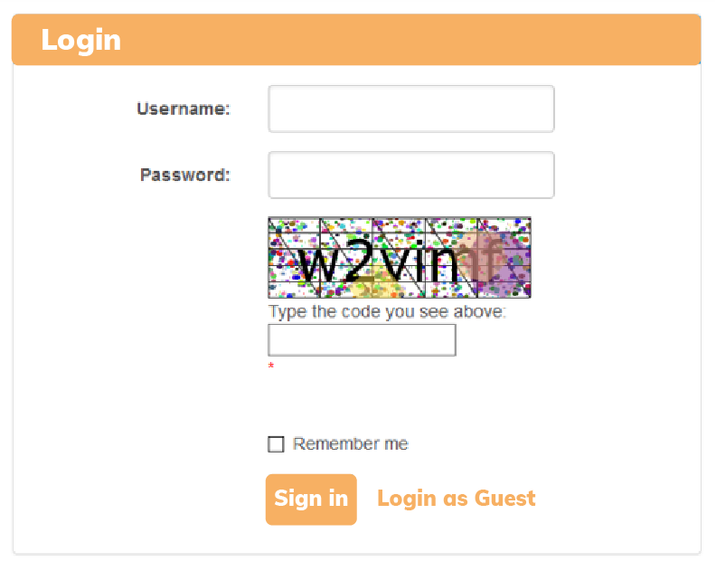
Authentication Story
The username and password should not be empty. Password must be 6 characters minimum.
Username and password are needed for authentication, and these fields should not be empty.
Password should be a minimum of 6 characters.
NFR: User should be navigated to the dashboard page in less than 3 seconds after logging in.
Notes:
Validations: Username and password cannot be empty. Password must be 6 characters minimum
NFR (Non Functional Requirements): Once the User has logged in, the user should be navigated to the Dashboard page in less than 3 seconds.

Slide 17


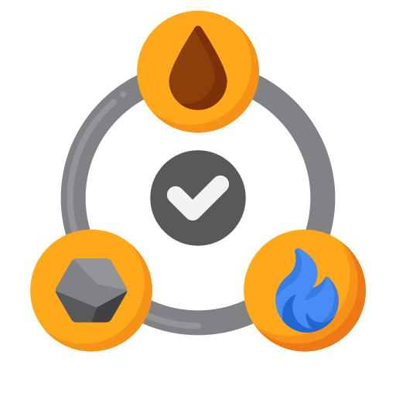

Product Story, Product List, and Product Details
Admin user should be able to manage products and add details regarding product, such as:
Price
and Discount
Material and
Size Description
Availability of
Quantity
Product Usage Video Tutorial
Notes:
Summary: As an admin user I should be able to manage products
Description: Admin user should be able to add details regarding product such as:
pricing, discount, product’s material description, size information, quantity available, product images, a video tutorial of its usage.

Slide 18
Product Story, Product List, and Product Details
The screen should be divided into two parts. The first part should display the list of products, and the second part should show the description of the product.
Products List
Products Description
Product 1
Product 2
Product 3
Product 4
…..
Product 1
Description:
Size:
Price:
Availability:
Notes:
Acceptance Criteria: Screen should be divided into two parts. In the first part, list products should be shown and in the second part, the product's details form should appear when selecting an existing product or when adding a new one.

Slide 19
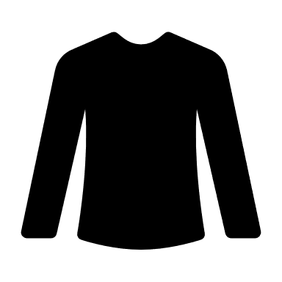
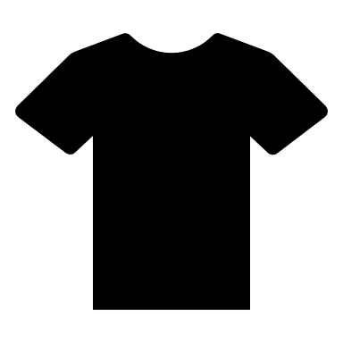
Product Story, Product List, and Product Details
At least two product images for each product must be uploaded, including its price, size, and availability details.
Products List
Products Description
Product 1
Product 2
Product 3
Product 4
…..
Product 1
Description:
Size:
Price:
Availability:
Product Image:
Notes:
Validations: At least 2 product images to be uploaded for each Product. Product’s pricing, various sizes and inventory information to be made available.
NFR (Non Functional Requirements): NA

Slide 20
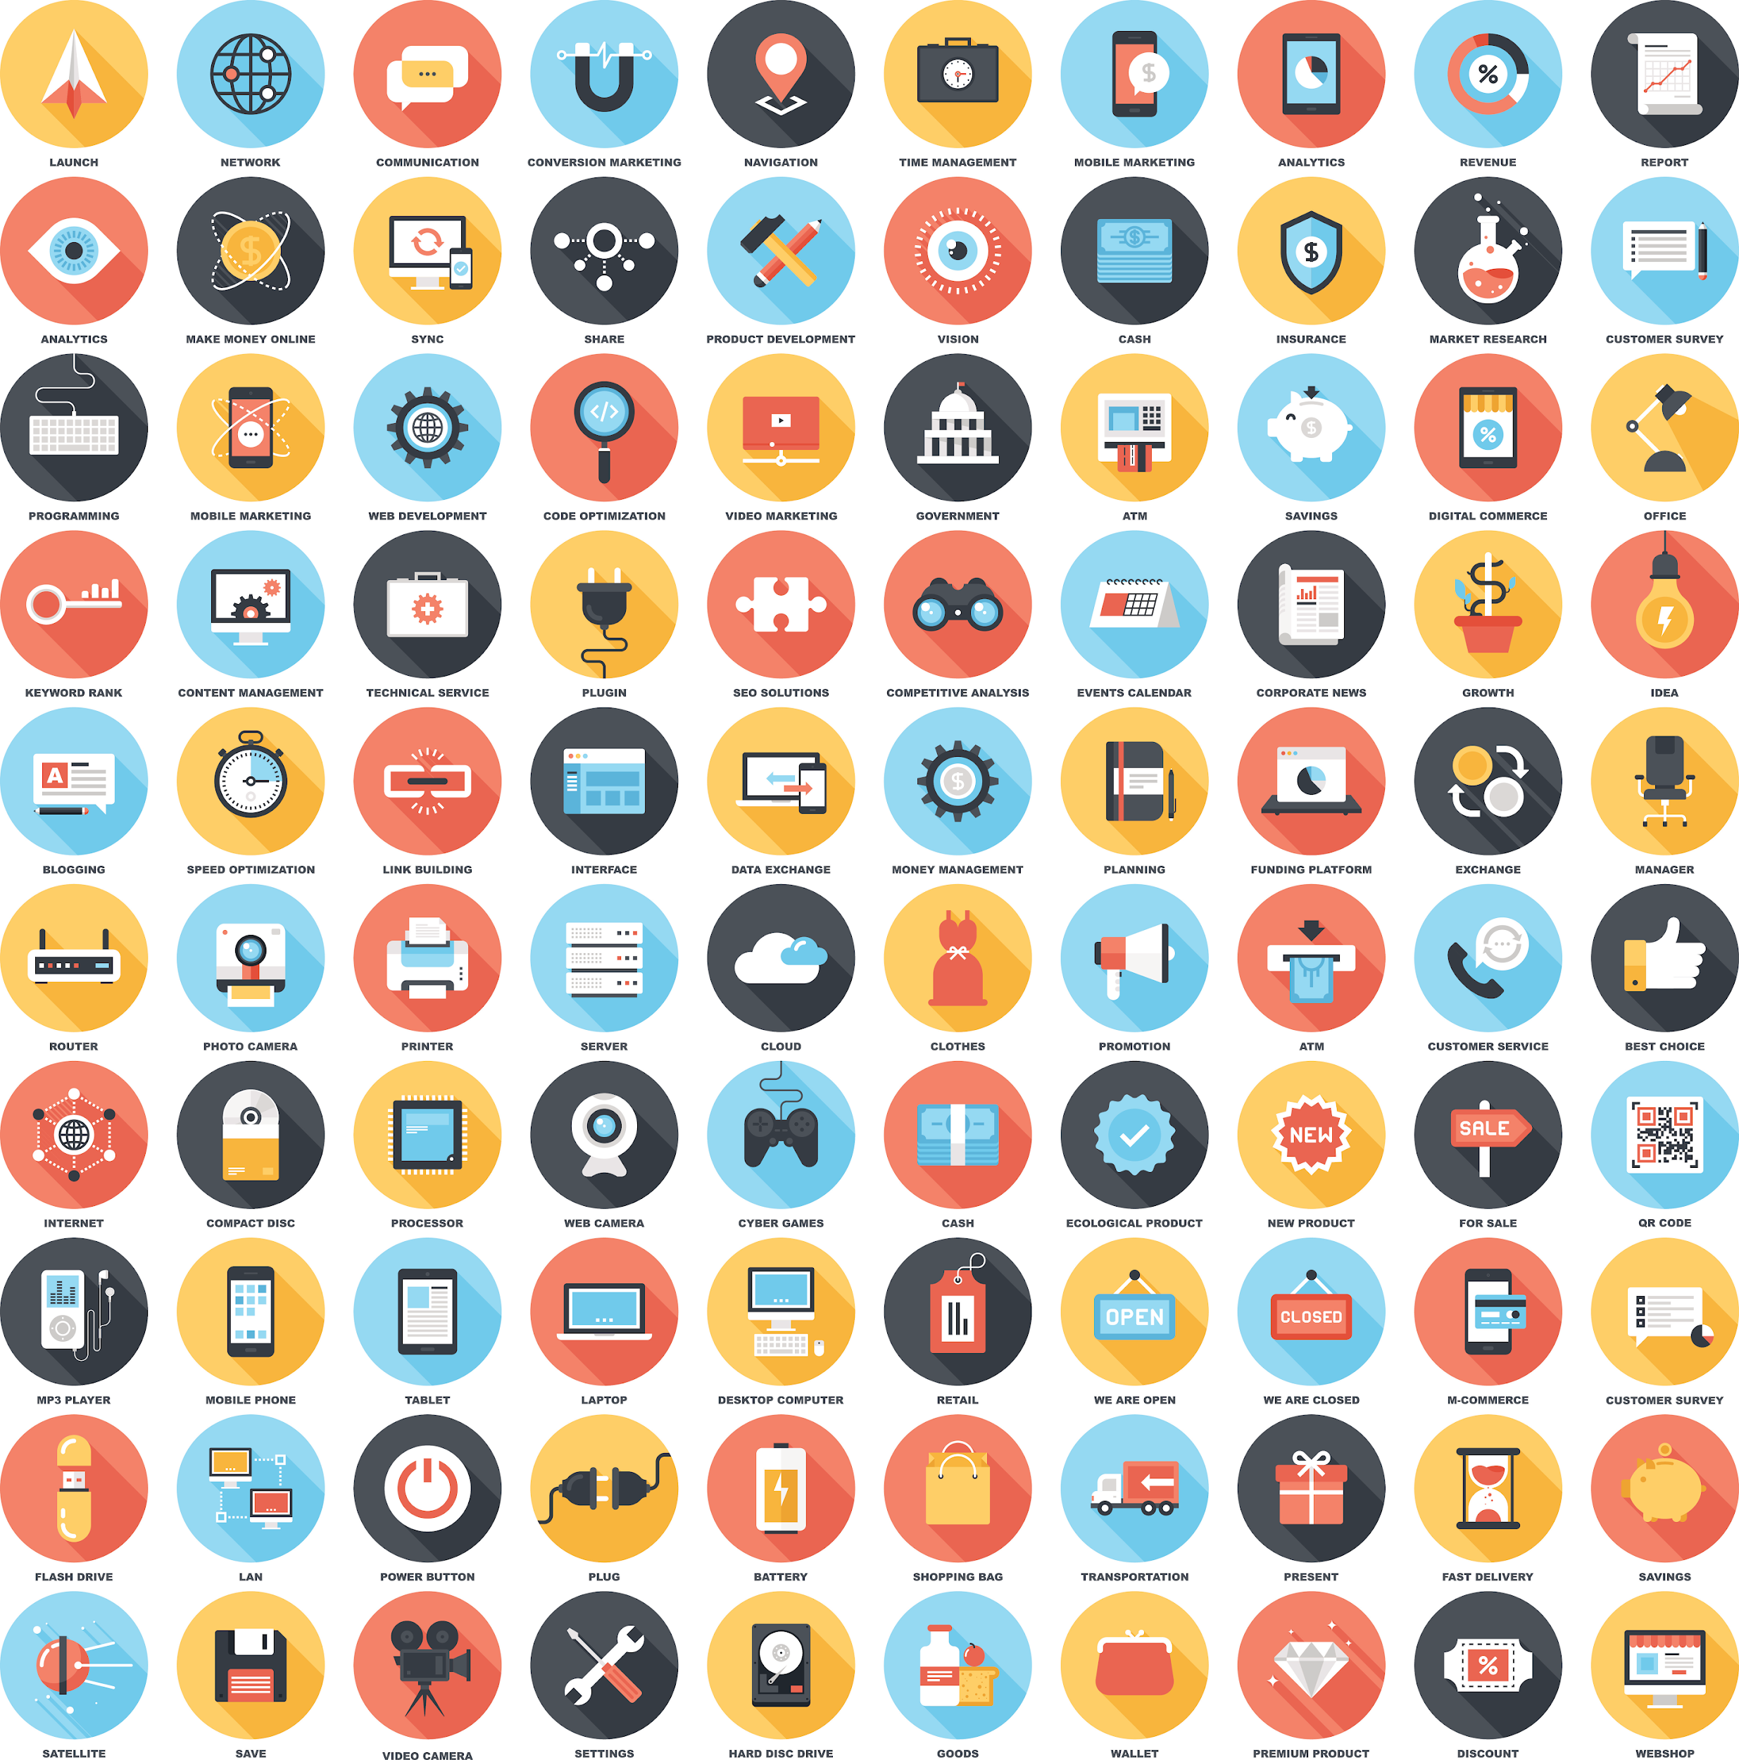
User’s Story
Admin user should be able to access users’ data and monitor newly registered users and frequently visited sections by the users.
Notes:
Summary: As an admin user, I should be able to access users’ data.
Description: As an admin user, I want to monitor newly registered users. Users can be filtered by date of registration. Also user’s activities such as frequently visited sections in the end user app.

Slide 21
User’s Story
By default, the user list page should be empty.
Then, users can be filtered using user filtration criteria. After filtration, the web page is divided into two parts.
The first part shows a list of users, and the second part shows user descriptions, such as date of registration and activity level.
Notes:
Acceptance Criteria: By default, the user list page should be empty.
Then, users can be filtered using user filtration criteria. After filtration, the web page is divided into two parts.
The first part shows a list of users, and the second part shows user descriptions such as date of registration, activity level, etc.

Slide 22
User’s Story
User List
User Description
Filter by
User 1
Date of registration:
No. of orders placed:
Interested in:
Activity level:
Frequently active
Last active
Date of registration
User 1
User 2
User 3
User 4
…….
Notes:
Acceptance Criteria: By default, the user list page should be empty.
Then, users can be filtered using user filtration criteria. After filtration, the web page is divided into two parts.
The first part shows a list of users, and the second part shows user descriptions such as date of registration, activity level, etc.

Slide 23
User’s Story
The date format should be validated before sending requests for users' lists.
Users List
User Description
Filter by
User 1
Date of registration:
No. of orders placed:
Interested in:
Level of activity:
Frequently active
Last active
Date of registration
User 1
User 2
User 3
User 4
…….
NFR: Retrieval of users should be seamless in a maximum of 10 seconds.
Date format should be validated.
Notes:
After user list retrieval, the web page should be divided into two parts. In the first section list of users to be displayed. In the second section, selected user’s data should be displayed.
Validations: Date format should be validated before sending requests for users.
NFR (Non Functional Requirements): Retrieval of users should be seamless in a maximum of 10 seconds.

Slide 24
Order Story
Admin user should be able to view new orders as well as finished orders.
Admin user should be able to manage order status such as:
Availability of ordered products
Order transition information
Notes:
Summary: As an admin user, I should be able view new orders as well as finished orders.
Description: As an admin user, I want to manage orders stats such as availability of products in order and order transition information.

Slide 25
Order Story
The web page is divided into three sections.
New Orders
Ongoing Orders
Halt State
Order 45
Order 46
Order 47
Order 48
…..
Order 39
Order 40
Order 43
Order 44
…..
Order 28
Order 30
Order 35
Order 41
…..
Notes:
Acceptance Criteria: In the web page, three sections should be there. In the first section list of newly placed orders should be there. In the second section, a list of ongoing orders should be there. In the third section, orders which are in halt state due to product’s non availability should be displayed.

Slide 26
Order Story
While processing the orders, the admin user should validate the availability of the products in the inventory.
New Orders
Ongoing Orders
Halt State
Order 45
Order 46
Order 47
Order 48
…..
Order 39
Order 40
Order 43
Order 44
…..
Order 28
Order 30
Order 35
Order 41
…..
Check for availability
Notes:
When selecting any order, the user should navigate to another page where all the details of the selected product should display with the availability to update details like product’s transmitting details.
Validations: When processing order, the availability of products in the inventory should be validated first.
NFR (Non Functional Requirements): NA

Slide 27
Payment Story
Admin user should be able to monitor and view the list of orders whose payment status is pending or in a disputed state.
Order 45
Order 46
Order 47
Order 48
…..
Order List
Pending payments including refund orders should be coded with different colours.
Notes:
Summary: An admin user should be able to monitor payment status of orders.
Description: A list of orders whose payment status is in pending or disputed state.

Slide 28
Payment Story
On the web page, a list of all pending payments, including orders requested for refund should be color coded to differentiate for easy recognition.
Order 45
Order 46
Order 47
Order 48
…..
Order List
Orders requested for refund
Payment pending orders
Notes:
Acceptance Criteria: On the web page, a list of all pending payments, including refund required orders should be color coded to differentiate for easy recognition.
Validations:NA
NFR (Non Functional Requirements): NA

Slide 29
Shipping Story
Admin user should be able to view orders which are ready for shipment and in transition.
Admin user should be able to update the delivery date, package’s current location for end user reference.
Orders
Orders
Orders
Orders
Orders
Orders
Order 45
Order 46
Order 47
Order 48
Order 39
Order 40
Order 43
Order 44
Order 28
Order 30
Order 35
Order 41
Orders that are on their way to the ordered address.
By selecting any order, admin user can update the delivery date, package’s current location.
Notes:
Summary: An admin user should be able to view orders which are ready for shipment and are in transition.
Description: A list of orders whose all ordered products are available to dispatch and which are on their way to the ordered address. And by selecting any order, the user can update the delivery date, package’s current location so the end user can stay updated about their order.
Acceptance Criteria: NA
Validations:NA
NFR (Non Functional Requirements): NA

Slide 30
User Stories for End User Web App Epic
Notes:
User web app is our second project. In this project, we will maintain and manage various modules. For example: showing products to the Users, Giving them options to manage the shopping carts, wish listing the products, and placing the orders.

Slide 31
Authentication Story
The end user should be able to login into the end-user app. Also, acquire access member features such as placing the order and checking order status.
The end user should authenticate using email and password with an optional captcha verification. The register option should be made available for new users.
Register
Notes:
Summary: The end user should be able to login into the end-user app. Also, acquire access member features such as placing the order and checking order status.
Description: An end user, would want to authenticate themselves with email and password with optional captcha verification in order to have access to the member section. The end user should be able to register if they do not have an account.

Slide 32

Authentication Story
A web page with text fields for username and password with a login button to log in to the system should be available, along with another web page for new user registration.
The username and password cannot be empty. Password must be of 6 characters minimum.
Notes:
Acceptance Criteria: A Web page with text fields for username and password with a login button to login to the system should be available. Another Web Page for registration asking name as additional field. Even though the User is not authenticated, User must be able to see the Home Page with Products for browsing.
Validations: Username and password cannot be empty. Password must be 6 characters minimum
NFR (Non Functional Requirements): Once the User has logged in/registered, the user should be navigated to the Home page with details in less than 3 seconds.

Slide 33
Profile Story
End user should update basic information such as name, email, and delivery address.
A web page should have the option for the user to edit details.
All the fields should be mandatory to fill.
Notes:
Summary: As an end user i should be able to update my basics information.
Description: As an end user, I want to update my basic information about myself such as name, email, delivery address etc.
Acceptance: A web page of user’s profile with option of editing details. A prompt list of fields to edit basic details should appear.
Validations: All the fields should be mandatory to fill.
NFR (Non Functional Requirements): NA

Slide 34
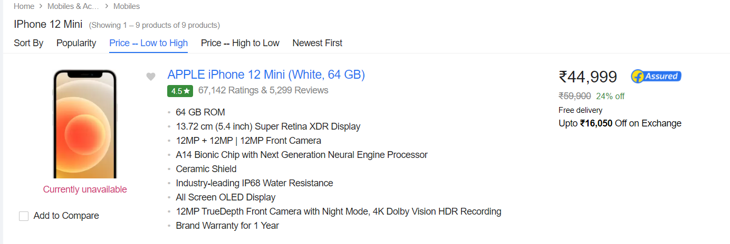
Product Story
The end user should view details of the product such as its image, material, user’s review.
Notes:
Summary: As an end user I should be able to view product details.
Description: As an end user, I want a page where product images, a video, product material and may be user’s reviews about the product.

Slide 35
Product Story
A web page should have two sections.
The first section should show product images and video.
The second section should show product pricing, material description.
User reviews should be under both sections, with the latest ones on the top of the list.
Notes:
Summary: As an end user I should be able to view product details.
Description: As an end user, I want a page where product images, a video, product material and may be user’s reviews about the product.
Acceptance Criteria: A web page with two sections, in first one product images and video should be displayed in vertical direction. In the second section, product pricing, material description should be displayed. The user reviews should be under both sections with the latest ones on the top of the list.

Slide 36
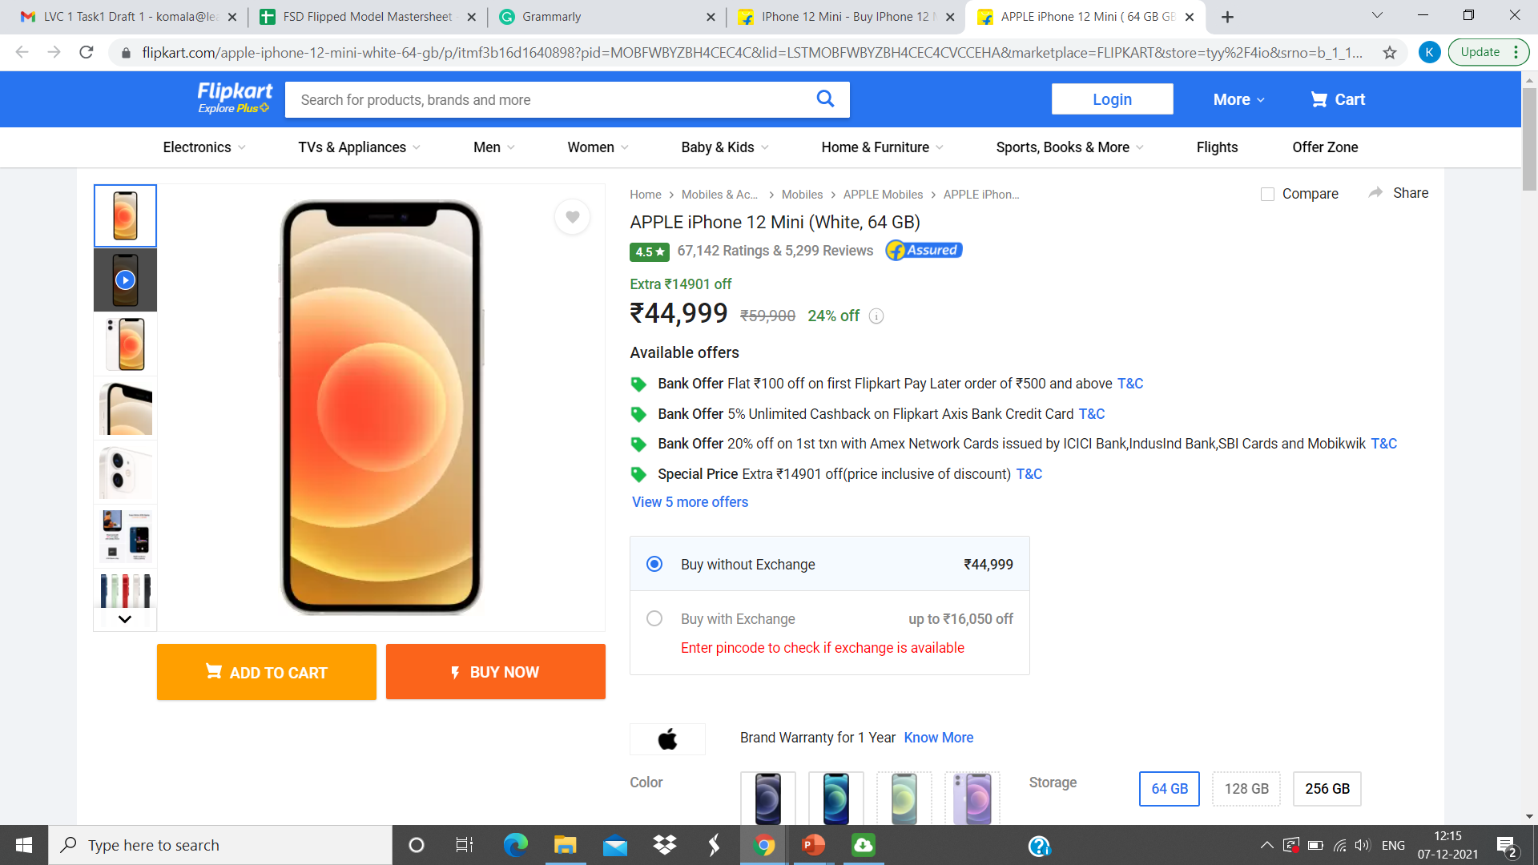
Product Story
Product description
Product image and video section
Notes:
Summary: As an end user I should be able to view product details.
Description: As an end user, I want a page where product images, a video, product material and may be user’s reviews about the product.
Acceptance Criteria: A web page with two sections, in first one product images and video should be displayed in vertical direction. In the second section, product pricing, material description should be displayed. The user reviews should be under both sections with the latest ones on the top of the list.

Slide 37
Product Story
Before placing the order, the availability of the product in the inventory should be validated.
Notes:
Validations: Availability of product in inventory should be checked before adding it to the order.
NFR (Non Functional Requirements): NA

Slide 38
Wishlist Story
The end user should be able to add products to the wishlist page.
Notes:
Description: As an end user, I want a wishlist page where all the wishlisted products for later reference should be displayed.

Slide 39
Wishlist Story
There should be an option to add a product to the wishlist for every product.
In the wishlist page, a list of products should be displayed in the form of a list, and an option should be available to place an order.
Availability of product in inventory should be checked before adding wishlist products to the orders.
Notes:
Acceptance Criteria: With every product, an option to add a product to wish list should be displayed as an icon. In the wishlist page, a list of wishlisted products should be displayed in the list form. And an option to add these products into the order.
Validations: Availability of product in inventory should be checked first before adding the wishlisted products to the order.
NFR (Non Functional Requirements): NA

Slide 40
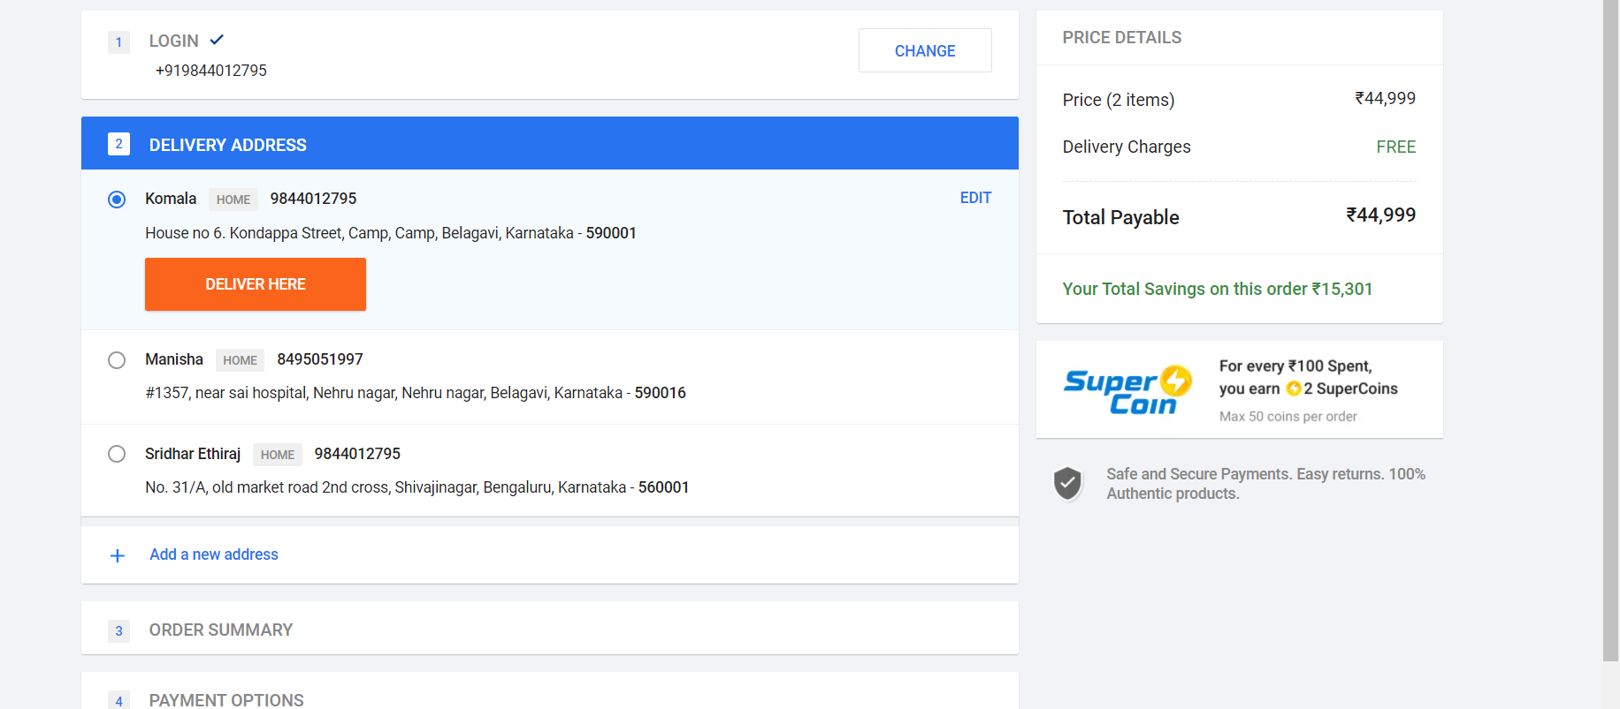
Checkout Story
The end user should view the checkout page to order the products with payment options.
Name
123456789
Address
Notes:
Description: An end user should be able to view the checkout page where all the products are displayed from the order with payment options.

Slide 41
Checkout Story
On the checkout page, there should be two sections.
The first section should show the list of all ordered products.
The second section should show details for payment.
Availability of the product and delivery of the product to the selected delivery address should be checked.
Notes:
Acceptance Criteria: In the checkout page, there should be two sections. In the first one, all ordered products should display in vertical form. In the second section details of payment should be displayed with the option of selection of payment mode for the order.
Validations: Availability of product in inventory and delivery of order to the selected delivery address.
NFR (Non Functional Requirements): NA

Slide 42
Payment Story
The end user should review the payment summary before placing an order.
There should be a summary of orders on the payment page, with the option to change the delivery address and mode of payment.
In the online mode of payment, the payment amount should be validated.
Notes:
Description: As an end user, I want a payment review page where payment summary should display with option of change of any detail.
Acceptance Criteria: In the payment page, there should be a summary of the whole order in vertical form. With the option of change of delivery address and payment mode
Validations: amount should be validated in case of online mode of payment.
NFR (Non Functional Requirements): NA

Slide 43
Working with JIRA
Notes:
JIRA is a project management tool used by agile teams. JIRA uses scrum framework with which software teams can manage the most of complex projects by through collaboration. With JIRA scrum board tool teams can work around their goal and promote iterative, incremental delivery.

Slide 44
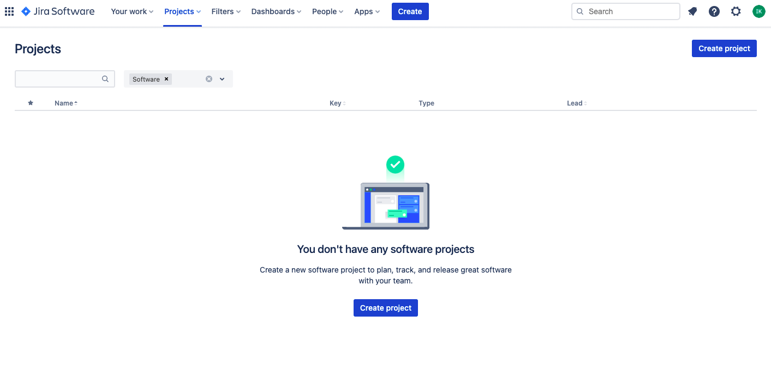
Create Project in JIRA
After creating an account in JIRA, the first step is to create a project to manage with Agile.
Notes:
After you create your account on JIRA, first thing to do is to create a Project which you wish to manage with Agile

Slide 45
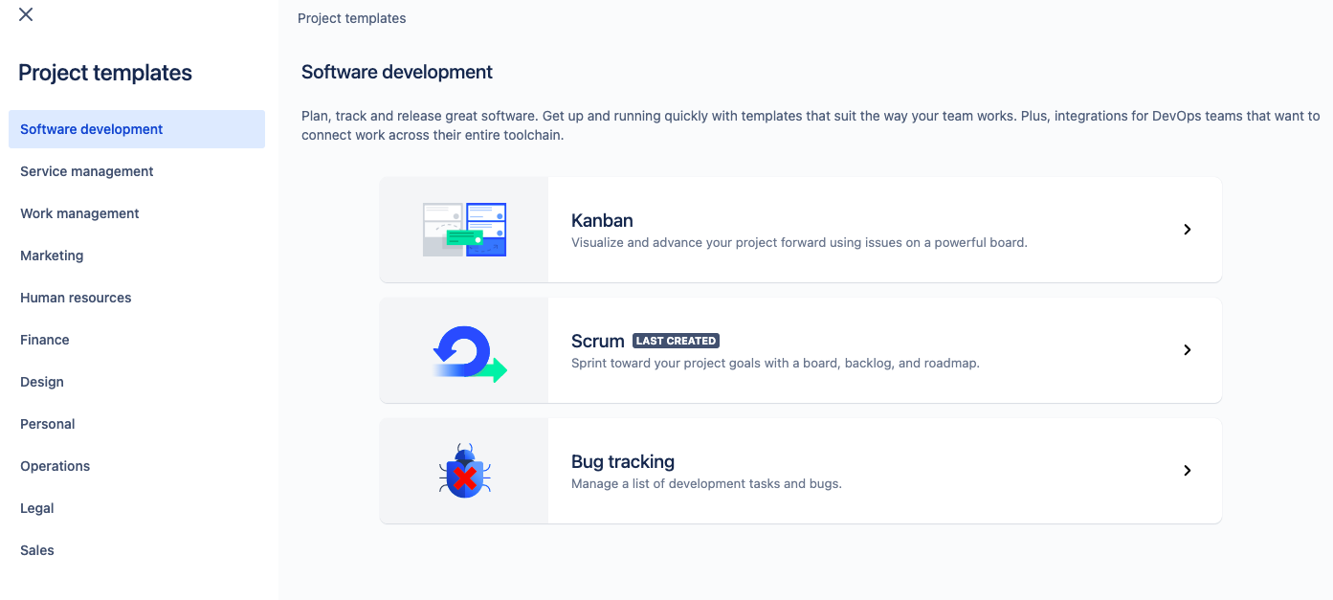
Different Project Options
When the user clicks on Create Project, three different ways to create a Project in JIRA are displayed. Scrum is preferred as it is easy to manage a project using Agile.
Notes:
After we click on Create Project, we will get 3 different ways to create Project. Lets, use Scrum which is closest to manage project using Agile

Slide 46
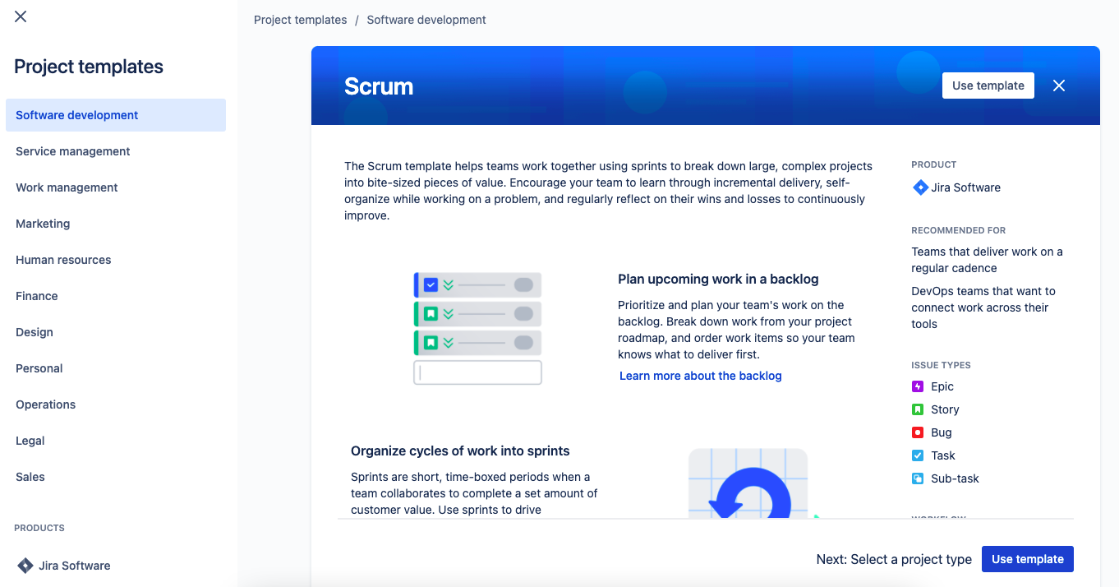
Scrum Template
With the Scrum project theme, the user can plan and create Sprints and break down a complex project into small projects.
cc
Notes:
Let's continue with the Scrum Project theme. With this theme, we will be able to plan and create Sprints for the Project and break down a larger complex project.

Slide 47
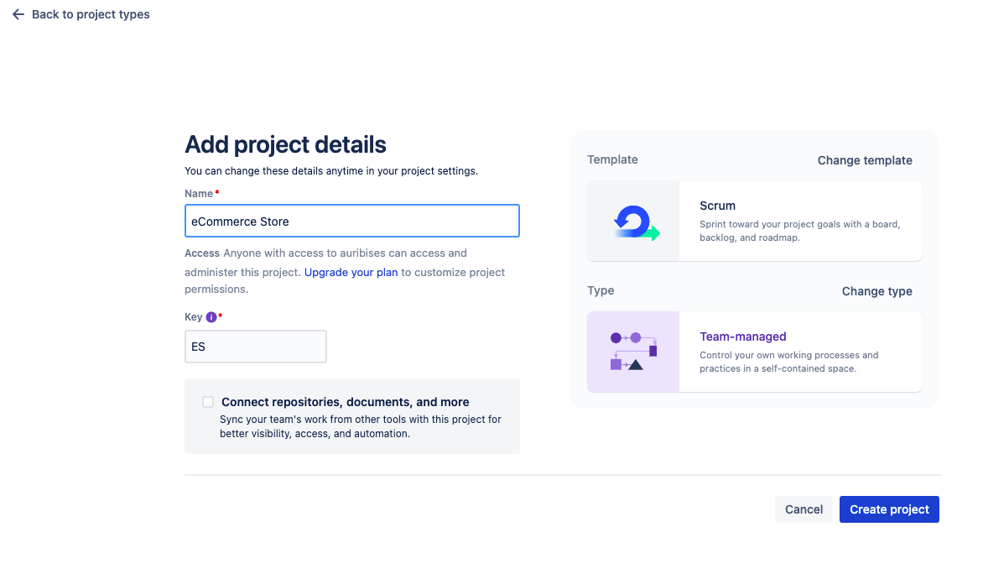
Project Details
Next, the user can add details of the project, including the name of the project. A key will be auto-generated for the project, and it can be changed per the requirement.
Notes:
Add the details of your project which includes the name. A key will be auto generated for the Project and can be changed per the requirement.

Slide 48
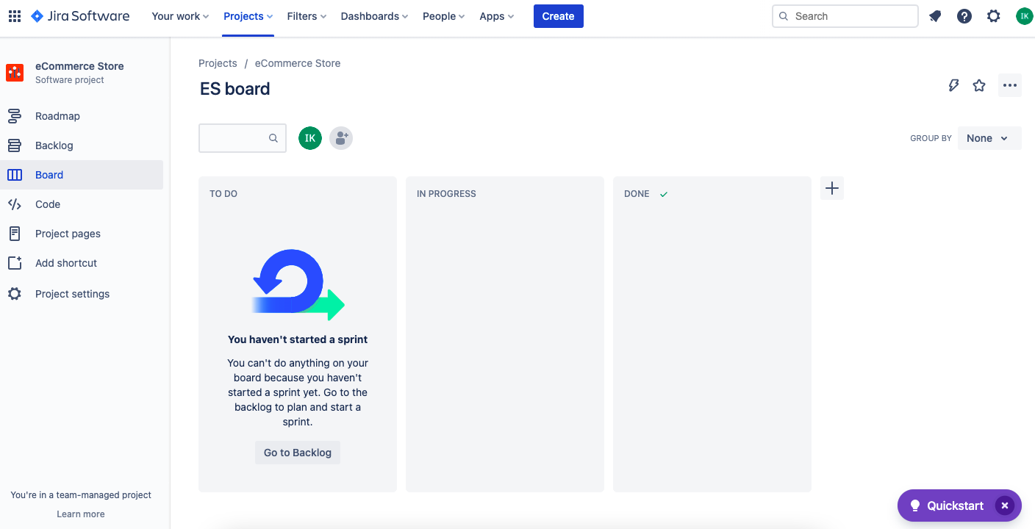
Project Home Page
After creating and adding the project, the user is redirected to the home page with Boards Options.
In Boards, the task can be grouped as To-Do, In Progress, and Done. If required, any custom board can also be added.
Notes:
Once, the project is created and added, you will be navigated to the home page with Boards Options. In the Boards we can classify the tasks as ToDo, In Progress and Done. Any custom board can also be added.

Slide 49
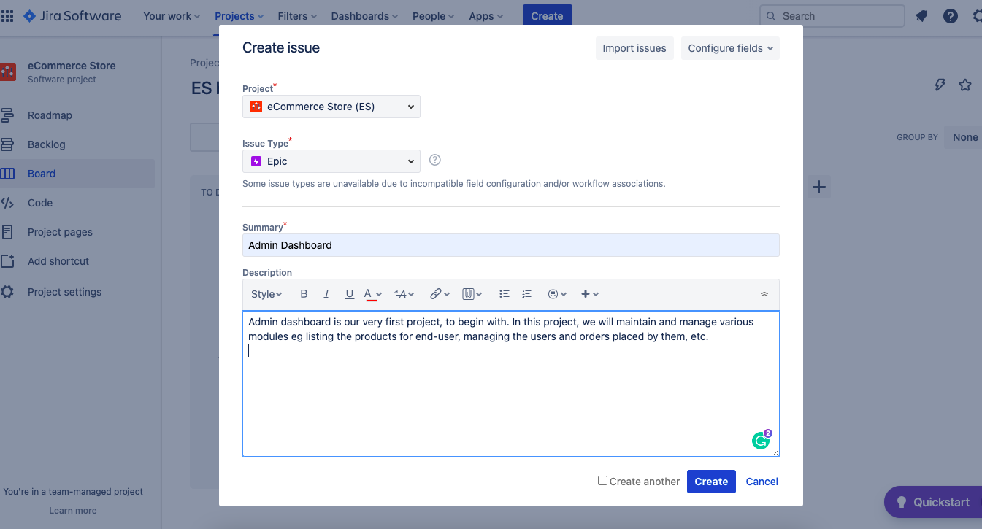
Create Epic
The next step is to create Epics. Click Create button on the project home page to create an Issue.
Notes:
Next step is to work on creating Epics. In our project we have discussed 2 of the Epics. Firstly to have Admin Dashboard and next one as Web App for End Users. So here we will click on create button on the project home page to get an option to create an issue.

Slide 50
Create Epic
The issue can be Epic, Story, Task, or a Bug. Select Epic in Issue Type and write a summary and detailed description.
Notes:
Issue can be Epic, Story, Task or a Bug. So we will choose Epic and write some brief summary and detailed description for it.

Slide 51
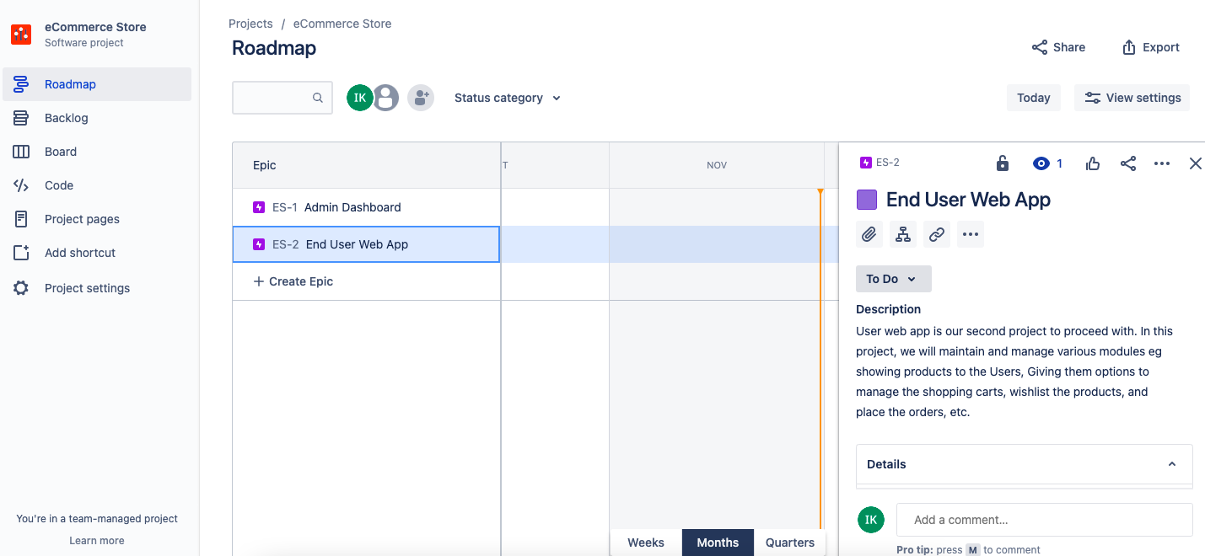
Road Map
The user can view added Epics in the Projects Roadmap Option. Moreover, when the user selects any epic, its summary and description can be seen.
Notes:
In the Projects Roadmap option, we will be able to see the added Epics and on selecting the same, its summary and detailed description can be seen.

Slide 52
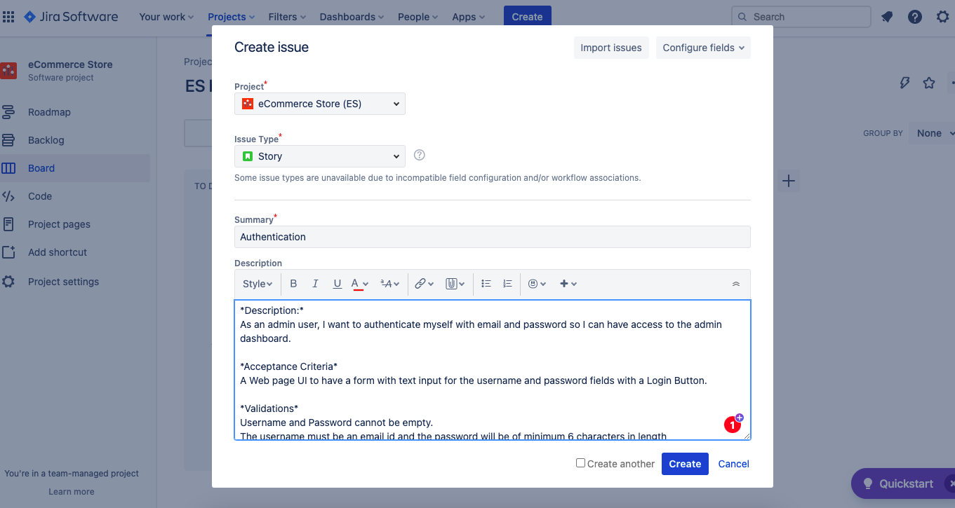
User Story
Similarly, the user can create an issue type as Story and write complete details in the description section.
Notes:
Similarly, the user can create an issue type as Story and write complete details in the description section.

Slide 53
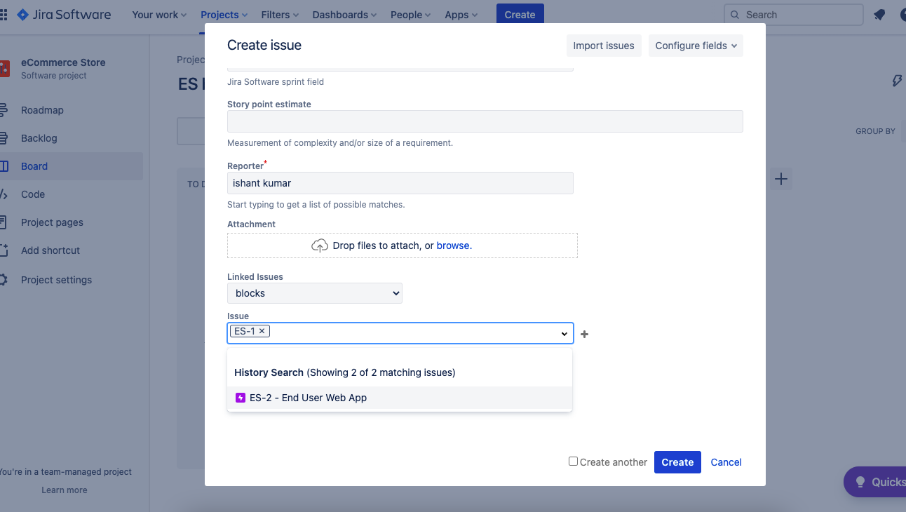
Link Story to Epic
While creating the story, an option to link it to the Epic is also available in the dropdown.
Notes:
While creating story, we will get an option to link it to the Epic in the same form with options for Epics coming in the dropdown.

Slide 54
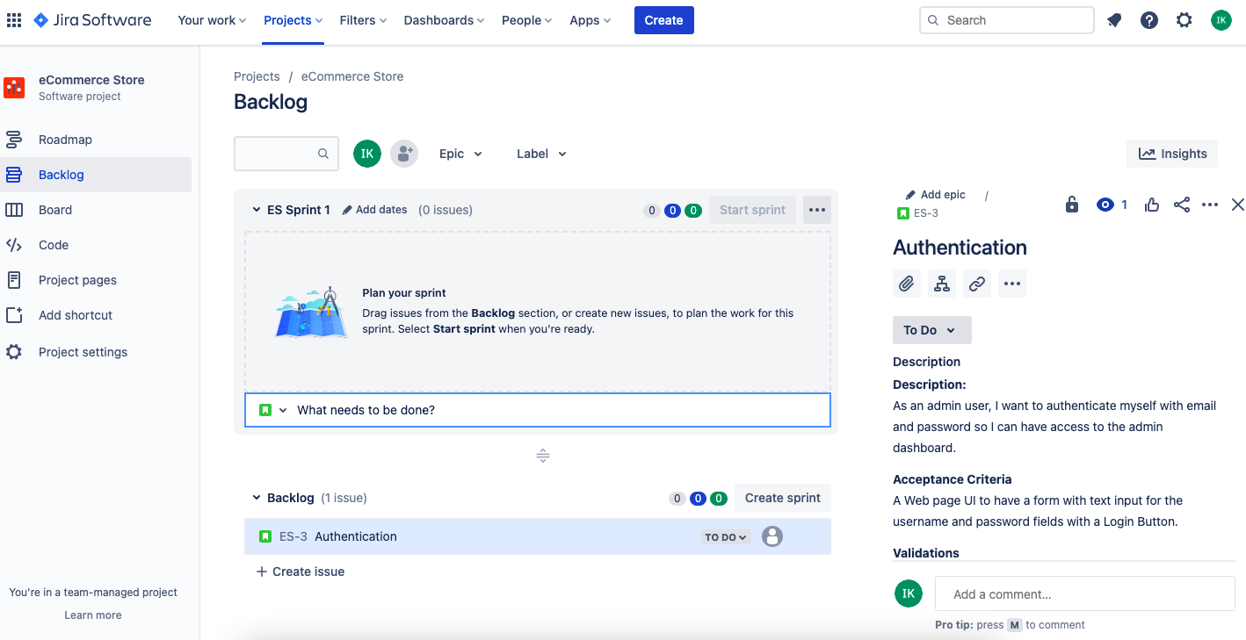
Backlog
After successfully creating the Epic story, it is listed as a Backlog in the JIRA Project Dashboard. Now, the user can start writing technical tasks to implement the User story.
Notes:
After we successfully create the story for the Epic, the same will be listed as a Backlog in the JIRA Project Dashboard. In the Backlog, we can now start writing some technical tasks to be done to implement the User story.

Slide 55
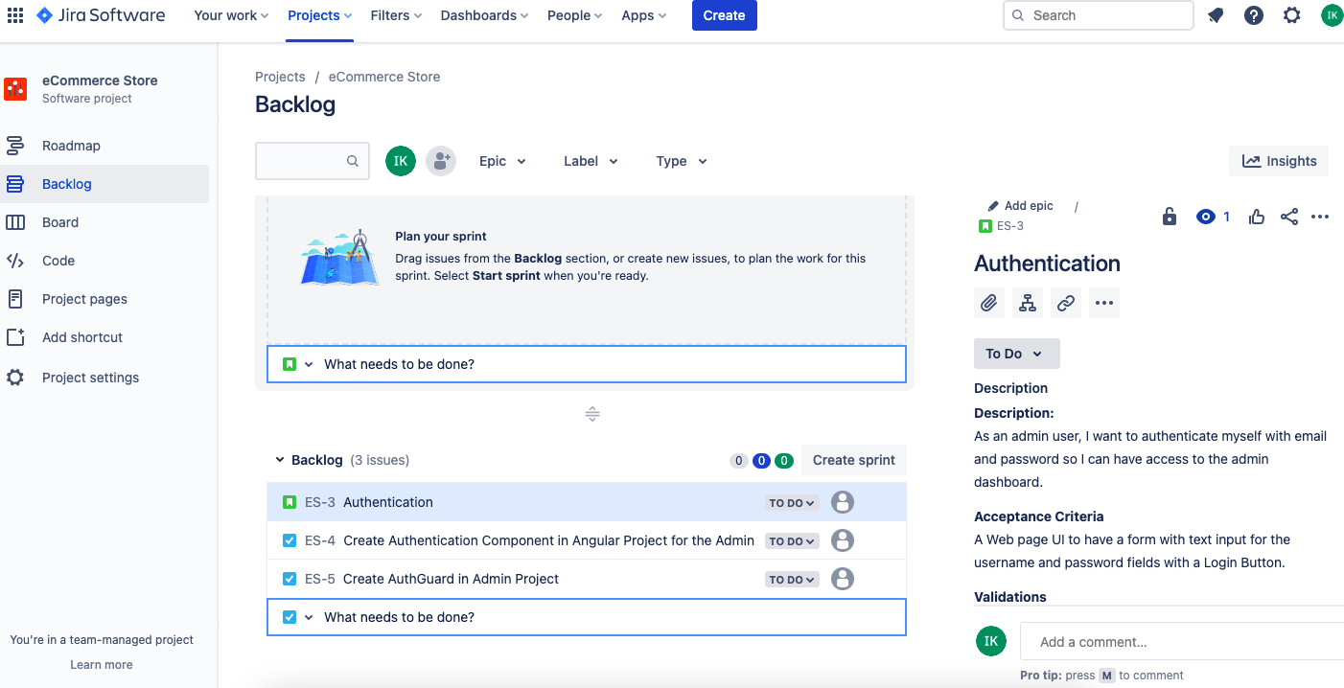
Tasks
JIRA asks to create tasks in a great UX manner. Users can continue creating tasks and assign them to the team member.
Notes:
JIRA, will ask us to create tasks in a great UX manner. Simply keep on creating the tasks and the same can be assigned to the team member.

Slide 56
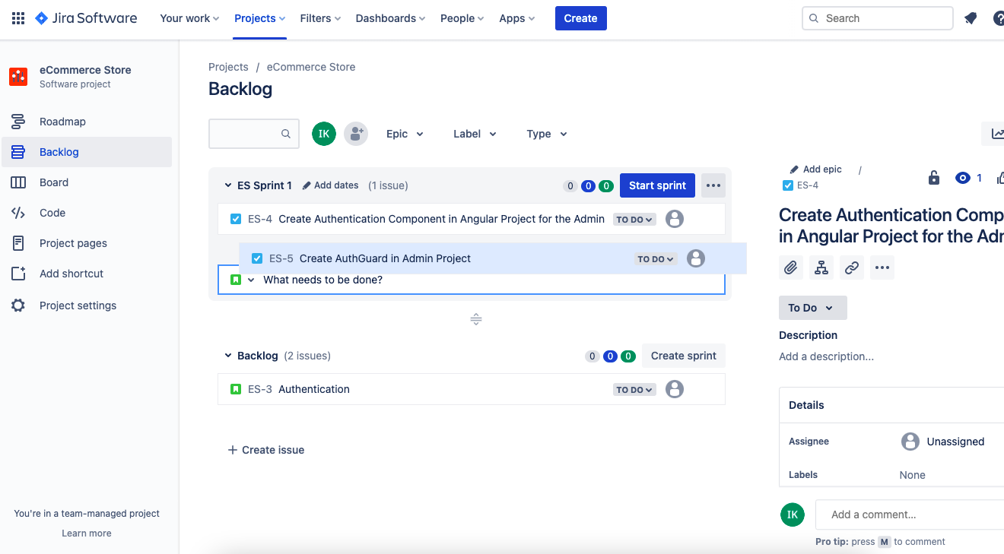
Sprint Planning
By default, a Sprint in the backlog section is displayed by the name Sprint 1, in which tasks can be added and planned.
Notes:
By default a Sprint in the backlog section is displayed by the name Sprint 1, in which tasks can be added and planned.

Slide 57
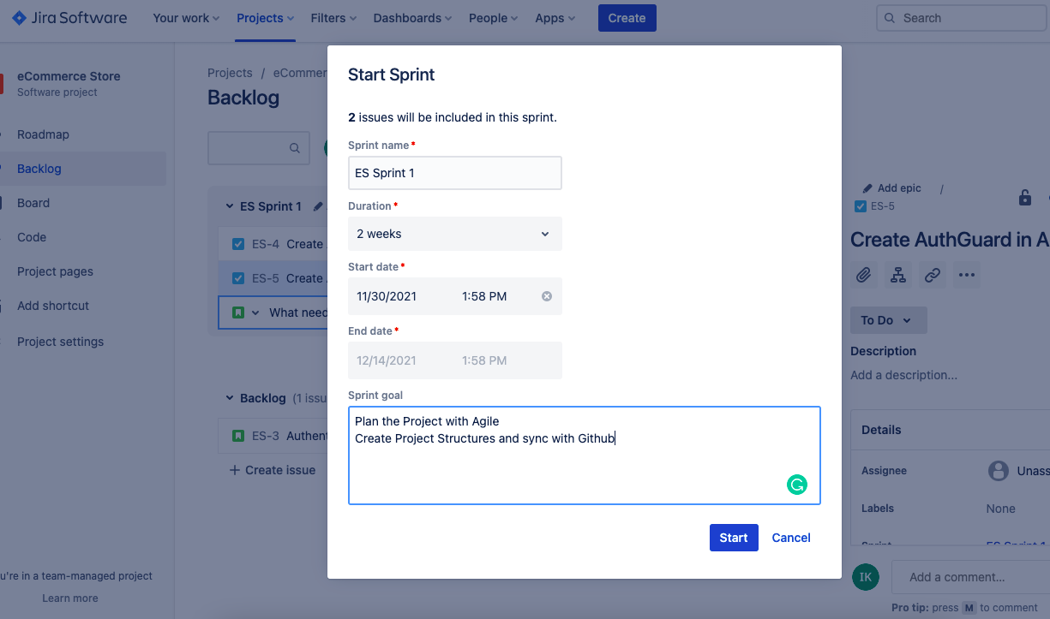
Starting a Sprint
To start the Sprint, fill in the details regarding name, duration, or customized date range for the duration.
Notes:
To start the Sprint, fill in the details regarding name, duration, or customized date range for the duration.

Slide 58
Create Project Structure and Sync with GitHub

Slide 59
Creating Web Admin Dashboard Project Structure with Angular and Syncing with GitHub
Notes:
Admin dashboard is our very first project, to begin with. In this project, we will maintain and manage various modules eg listing the products for end-user, managing the users and orders placed by them, etc.

Slide 60
Creating a New Angular Project
The Angular CLI is a command–line interface tool used to initialize, develop, and maintain Angular applications through command shell.
Notes:
In order to create a Project with Angular, the very first step is to Install the angular CLI.
The Angular CLI is a command-line interface tool with which we can initialize, develop, and maintain Angular applications through command shell

Slide 61
Creating a New Angular Project
Some useful commands are:
Task | Command
Generate a project | ng new my-first-project
Change directory in which project is created | cd my-first-project
Compile and execute the project | ng serve
Notes:
In order to create a Project with Angular, the very first step is to Install the angular CLI.
The Angular CLI is a command-line interface tool with which we can initialize, develop, and maintain Angular applications through command shell
Some useful commands are as below:
Command to generate a project
ng new my-first-project
Change directory in which your project is created
cd my-first-project
Compile and execute the project
ng serve
~~~~~~~~~~~~~~~~~~~~~~~~~~~
To create an angular project use command “ng new Admin-Dashboard”, then enter ‘y’ to enable routing in your project and then select the CSS for styles. You can see, git is initialized by default in the project so as to manage VCS.
We will get the following PROJECT STRUCTURE when we create a new project in Angular
.editorconfig
Configuration file for code editors.
.gitignore
Files which git should ignore
README.md
A documentation for the introduction of application.
angular.json
CLI configuration defaults for all projects in the workspace, including configuration options for build, serve, and test tools that the CLI uses
package.json
Configures node package manager dependencies that are available to all projects in the workspace.
package-lock.json
Provides version information for all packages installed into node_modules
src/
Directory where Source files for the project resides.
node_modules/
Directory where node_modules dependencies can be found
tsconfig.json
typescript configuration for projects in the workspace.

Slide 62
Creating a New Angular Project
Create an Angular project using below command in command shell.
Following options will appear:
Enter y to enable routing and select CSS for styles.
By default, git is initialized in the project to manage VCS.
ng new Admin-Dashboard
? Would you like to add Angular routing? Yes
? Which stylesheet format would you like to use? CSS
Notes:
~~~~~~~~~~~~~~~~~~~~~~~~~~~
To create an angular project use command “ng new Admin-Dashboard”, then enter ‘y’ to enable routing in your project and then select the CSS for styles. You can see, git is initialized by default in the project so as to manage VCS.

Slide 63
Creating a New Angular Project
Following project structure is created in a new Angular project:
CREATE admin-dashboard/README.md (1060 bytes)
CREATE admin-dashboard/.editorconfig (274 bytes)
CREATE admin-dashboard/.gitignore (604 bytes)
CREATE admin-dashboard/angular.json (3093 bytes)
CREATE admin-dashboard/package.json (1077 bytes)
CREATE admin-dashboard/tsconfig.json (783 bytes)
CREATE admin-dashboard/.browserslistrc (703 bytes)
CREATE admin-dashboard/karma.conf.js (1432 bytes)
CREATE admin-dashboard/tsconfig.app.json (287 bytes)
CREATE admin-dashboard/tsconfig.spec.json (333 bytes)
CREATE admin-dashboard/src/favicon.ico (948 bytes)
CREATE admin-dashboard/src/index.html (300 bytes)
CREATE admin-dashboard/src/main.ts (372 bytes)
CREATE admin-dashboard/src/polyfills.ts (2820 bytes)
CREATE admin-dashboard/src/styles.css (80 bytes)
CREATE admin-dashboard/src/test.ts (788 bytes)
CREATE admin-dashboard/src/assets/.gitkeep (0 bytes)
CREATE admin-dashboard/src/environments/environment.prod.ts (51 bytes)
CREATE admin-dashboard/src/environments/environment.ts (658 bytes)
CREATE admin-dashboard/src/app/app-routing.module.ts (245 bytes)
CREATE admin-dashboard/src/app/app.module.ts (393 bytes)
CREATE admin-dashboard/src/app/app.component.css (0 bytes)
CREATE admin-dashboard/src/app/app.component.html (24617 bytes)
CREATE admin-dashboard/src/app/app.component.spec.ts (1100 bytes)
CREATE admin-dashboard/src/app/app.component.ts (219 bytes)
Notes:
We will get the following PROJECT STRUCTURE when we create a new project in Angular
.editorconfig
Configuration file for code editors.
.gitignore
Files which git should ignore
README.md
A documentation for the introduction of application.
angular.json
CLI configuration defaults for all projects in the workspace, including configuration options for build, serve, and test tools that the CLI uses
package.json
Configures node package manager dependencies that are available to all projects in the workspace.
package-lock.json
Provides version information for all packages installed into node_modules
src/
Directory where Source files for the project resides.
node_modules/
Directory where node_modules dependencies can be found
tsconfig.json
typescript configuration for projects in the workspace.

Slide 64
Creating a New Angular Project
Command | Use
.editorconfig | Configuration file for code editors.
.gitignore | Files which git should ignore.
README.md | A documentation for the introduction of application.
angular.json | CLI configuration defaults for all projects in the workspace, including configuration options for build, serve, and test tools that the CLI uses.
package.json | It configures node package manager dependencies that are available for all projects in the workspace.
Notes:
We will get the following PROJECT STRUCTURE when we create a new project in Angular
.editorconfig
Configuration file for code editors.
.gitignore
Files which git should ignore
README.md
A documentation for the introduction of application.
angular.json
CLI configuration defaults for all projects in the workspace, including configuration options for build, serve, and test tools that the CLI uses
package.json
Configures node package manager dependencies that are available to all projects in the workspace.

Slide 65
Creating a New Angular Project
Command | Use
package-lock.json | Provides version information for all packages installed into node_modules
src/ | Is the directory where source files for the project reside
node_modules/ | Is the directory where node_modules dependencies can be found
tsconfig.json | Is the typescript configuration for projects in the workspace
Notes:
package-lock.json
Provides version information for all packages installed into node_modules
src/
Directory where Source files for the project resides.
node_modules/
Directory where node_modules dependencies can be found
tsconfig.json
typescript configuration for projects in the workspace.

Slide 66
Web Admin Dashboard: Authentication Module

Slide 67
Authentication Module
Users who access the web admin dashboard, the authentication module is used for:
Validation of Users
Authorization of Users
Notes:
Authentication module will include validation and authorization of users who will access the web admin dashboard

Slide 68
Authentication Module
Components are the primary building block for Angular applications. Each component consists of:
An HTML template that declares what renders on the page.
A Typescript class that defines behavior.
A CSS selector that defines how the component is used in a template.
Optionally, CSS styles are applied to the template.
Notes:
Components are the main building block for Angular applications. Each component consists of:
An HTML template that declares what renders on the page
A Typescript class that defines behavior
A CSS selector that defines how the component is used in a template
Optionally, CSS styles applied to the template
Moving forward, we will now generate the components needed for the Admin Dashboard as per the User Stories in Agile.

Slide 69
Generating Auth Component
For terminal change directory to user project root folder use this command:
Then, execute the below command:
After execution, the following output is generated:
cd admin-dashboard
ng generate component auth
CREATE src/app/auth/auth.component.css
CREATE src/app/auth/auth.component.html
CREATE src/app/auth/auth.component.spec.ts
CREATE src/app/auth/auth.component.ts
UPDATE src/app/app.module.ts
Notes:
Open project in the terminal, then use command “ng generate component auth”, this will generate four files :
auth.component.css
auth.component.html
auth.component.spec.ts
auth.component.ts
And automatically the app.module.ts file will have the component definitions added.

Slide 70
Generating Auth Component
On terminal change directory to user project root folder using the command:
Then execute the below command:
After execution the following output is generated:
cd admin-dashboard
ng generate component auth
CREATE src/app/auth/auth.component.css
CREATE src/app/auth/auth.component.html
CREATE src/app/auth/auth.component.spec.ts
CREATE src/app/auth/auth.component.ts
UPDATE src/app/app.module.ts
Notes:
AuthGuard is a class which implements the interface CanActivate, to decide whether the user has access/permission to view specific page / route / path in the application or not.
So, for the admin dashboard, let us generate the same.
Generate auth guard in auth folder using command “ng generate guard auth/auth”, then select CanActivate interface to implement in this guard. This will generate two files:
auth.guard.spec.ts
auth.guard.ts

Slide 71
Generating Auth Guard
AuthGuard is a class which implements the interface CanActivate.
Generate auth guard in auth folder using command “ng generate guard auth/auth”, then select CanActivate interface to implement in this guard.
After execution the following output is generated.
CREATE src/app/auth/auth.guard.spec.ts
CREATE src/app/auth/auth.guard.ts
Notes:
AuthGuard is a class which implements the interface CanActivate, to decide whether the user has access/permission to view specific page / route / path in the application or not.
So, for the admin dashboard, let us generate the same.
Generate auth guard in auth folder using command “ng generate guard auth/auth”, then select CanActivate interface to implement in this guard. This will generate two files:
auth.guard.spec.ts
auth.guard.ts

Slide 72
Generating Auth Service
For successful implementation, add Auth Service in the Project.
ng generate service auth/aut
After execution, the following output is generated:
CREATE src/app/auth/auth.service.spec.ts
CREATE src/app/auth/auth.service.ts
Notes:
For the successful implementation we will also add up Auth Service in our Project.
Generate auth service in auth folder using command “ng generate service auth/auth”, this will generate two files:
auth.service.spec.ts
auth.service.ts

Slide 73
Web Admin Dashboard: Product Module

Slide 74
Generating Product-List Component
Product module includes product management. An admin user will implement the functionalities to manage products, such as:
Pricing Option
Discount Applicable
Material Description
Size
Quantity Available
Product Images
Notes:
Product Module includes the Product management. As an admin user we will implement the functionalities to manage products.
pricing option,
Discount applicable.
Material Description.
Size information,
Quantity available.
Product Images.

Slide 75
Generating Product-List Component
Generate product-list component in products folder using this command:
ng generate component products/productList
After execution, the following output is generated:
CREATE src/app/auth/product-list.component.css
CREATE src/app/auth/product-list.component.html
CREATE src/app/auth/product-list.component.spec.ts
CREATE src/app/auth/product-list.component.ts
UPDATE src/app/app.module.ts
Notes:
Generate product-list component in products folder using command “ng generate component products/productList” , this will generate 3 files:
product-list.component.css
product-list.component.html
product-list.component..ts
product-list.component.spec.ts
app.module.ts file will be updated for the component definition

Slide 76
Generating Product-View Component
In order to view the products, generate product-list component in products folder using this command:
ng generate component products/productView
After execution, the following output is generated:
CREATE src/app/auth/product-view.component.css
CREATE src/app/auth/product-view.component.html
CREATE src/app/auth/product-view.component.spec.ts
CREATE src/app/auth/product-view.component.ts
UPDATE src/app/app.module.ts
Notes:
In order to view the products, we will generate product-list component in products folder using command “ng generate component products/productView” , this will generate 3 files:
product-view.component.css
product-view.component.html
product-view.component..ts
product-view.component.spec.ts
app.module.ts file will be updated for the component definition

Slide 77
Web Admin Dashboard: Users Module

Slide 78
Generating User Component
Generate user component using this command:
ng generate component users
After execution, the following output is generated:
CREATE src/app/auth/users.component.css
CREATE src/app/auth/users.component.html
CREATE src/app/auth/users.component.spec.ts
CREATE src/app/auth/users.component.ts
UPDATE src/app/app.module.ts
Notes:
Generate users component using command “ng generate component users” , this will generate 3 files:
users.component.css
users.component.html
users.component..ts
users.component.spec.ts
app.module.ts file will be updated for the component definition

Slide 79
Web Admin Dashboard: Orders Module

Slide 80
Generating Orders Component
The admin dashboard must have insights on the orders placed by end users from their web app. Few of the details which would be required include:
View order details which will include products and their quantity.
Check the availability of products in order, and if not available, notify the user accordingly either manually or by the algorithmic approach.
Notes:
The admin dashboard must have insights on the Orders placed by End Users from their web app. Few of the details which would be required includes:
View order details which will include products and their quantity. Check Availability of products in order and if not then a way to notify the user accordingly either manually or by algorithmic approach

Slide 81
Generating Orders Component
Generate orders component using this command:
ng generate component orders
After execution, the following output is generated:
CREATE src/app/auth/orders.component.css
CREATE src/app/auth/orders.component.html
CREATE src/app/auth/orders.component.spec.ts
CREATE src/app/auth/orders.component.ts
UPDATE src/app/app.module.ts
Notes:
So lets generate product View orders component using command “ng generate component orders” , this will generate 3 files:
orders.component.css
orders.component.html
orders.component..ts
orders.component.spec.ts
app.module.ts file will be updated for the component definition

Slide 82
Web Admin Dashboard: Payment Module

Slide 83
Generating Payment Component
Admin must have the data for the transactions associated to the order, when user places it. An admin must be able to:
Manage
payments
Reject payments
Process payments partially
Notes:
Admin must have the data for the transactions associated to the Order, when user places the same.
Admin must be able to Manage payments, payment rejections, Partial processing etc.

Slide 84
Generating Payment Component
Generate user’s payment using this command:
ng generate component payment
After execution, the following output is generated:
CREATE src/app/auth/payment.component.css
CREATE src/app/auth/payment.component.html
CREATE src/app/auth/payment.component.spec.ts
CREATE src/app/auth/payment.component.ts
UPDATE src/app/app.module.ts
Notes:
Generate users payment using command “ng generate component payment” , this will generate 3 files:
payment.component.css
payment.component.html
payment.component..ts
payment.component.spec.ts
app.module.ts file will be updated for the component definition

Slide 85
Generating Payment Service
Services in Angular increase modularity and reusability.
Generate payment service in payment folder using this command:
ng generate service payment/payment
After execution, the following output is generated:
CREATE src/app/auth/payment.service.spec.ts
CREATE src/app/auth/payment.service.ts
Notes:
A component's job is to enable the user experience and nothing more. Services in Angular increase modularity and reusability. By separating a component's view-related functionality from other kinds of processing, you can make your component classes lean and efficient.
We will also use Payment Service for this module.
To generate payment service in payment folder using command “ng generate service payment/payment”, this will generate two files:
payment.service.spec.ts
payment.service.ts

Slide 86
Web Admin Dashboard: Shipment Module

Slide 87
Generating Shipment Component
In the shipment module of admin dashboard, the list of orders ready for shipment is shown.
It implements management of order transition from warehouse to user’s doorstep.
It updates order details and notifies the customer.
Notes:
In the Shipment module of Admin Dashboard, we will show the list of orders which are ready for shipment. Here we will implement the management of orders transition from warehouse to user’s door step for an example.
With various details of shipment like dispatch date, expected delivery date and current location of order package we will update the order details and notify the Customer.

Slide 88
Generating Shipment Component
Generate shipment component using this command:
ng generate component shipment
After execution, the following output is generated:
CREATE src/app/auth/shipment.component.css
CREATE src/app/auth/shipment.component.html
CREATE src/app/auth/shipment.component.spec.ts
CREATE src/app/auth/shipment.component.ts
UPDATE src/app/app.module.ts
Notes:
Generate users payment using command “ng generate component payment” , this will generate 3 files:
payment.component.css
payment.component.html
payment.component..ts
payment.component.spec.ts
app.module.ts file will be updated for the component definition

Slide 89
Generating Shipment Component
Generate shipment component using command:
ng generate component shipment
After execution the following output is generated:
CREATE src/app/auth/shipment.component.css
CREATE src/app/auth/shipment.component.html
CREATE src/app/auth/shipment.component.spec.ts
CREATE src/app/auth/shipment.component.ts
UPDATE src/app/app.module.ts
Notes:
Generate users payment using command “ng generate component payment” , this will generate 3 files:
payment.component.css
payment.component.html
payment.component..ts
payment.component.spec.ts
app.module.ts file will be updated for the component definition

Slide 90
Building the Project
To build the project execute:
npm run build
To test the output on the localhost use:
> ng serve -o
After execution, the following output is generated:
✔ Browser application bundle generation complete.
✔ Copying assets complete.
✔ Index html generation complete.
Initial Chunk Files | Names | Size
main.bb310dfd8e03708854b9.js | main | 214.81 kB
polyfills.9f1d9ffccfb9cf2e763b.js | polyfills | 36.21 kB
runtime.f3142626aa6e5ec05e95.js | runtime | 1.03 kB
styles.31d6cfe0d16ae931b73c.css | styles | 0 bytes
Notes:
Finally, let us build our project and see if everything works fine.
To build the project we will simply execute npm run build
To test the output on the localhost
You can use
> ng serve -o

Slide 91
Web Admin Dashboard: Pushing Project on GitHub

Slide 92
GitHub
Git is a distributed version control system designed to efficiently handle small to big projects.
In this project, Git is used for VCS and syncing projects in GitHub.
Notes:
While developing the project, securing the code is important. At the same time when team is working on the project we need to sync the code and advancements day to day.
Git is a distributed version control system designed to handle everything from small to very large projects with speed and efficiency. We will use Git as VCS and sync our projects on github. Lete now see how we can sync our admin dashboard on the git.

Slide 93
Git init Command
Git is initialized by default when angular project is created.
Type the command to add all the files:
git add .
Check git status for the files added:
git status
Output of git status:
On branch master, changes to be committed: use "git restore --staged <file>..." to unstage:
modified: src/app/app.module.ts
new file: src/app/auth/auth.component.css
new file: src/app/auth/auth.component.html
new file: src/app/auth/auth.component.spec.ts
new file: src/app/auth/auth.component.ts
Notes:
Git is by default initialized whenever we create our angular project. So we just need to add all the files to the repo.
Use git add . to add the files
Than we will commit the changes.
git commit -m initial commit“
Git commit command used to create a snapshot with message.

Slide 94
Git init Command
Commit the files added for push operation:
git commit -m "initial commit"
Output of git commit:
[master 42e3828] initial commit
Committer: username <admin@username-MacBook-Air.local>
Notes:
Git is by default initialized whenever we create our angular project. So we just need to add all the files to the repo.
Use git add . to add the files
Then we will commit the changes.
git commit -m initial commit“
Git commit command used to create a snapshot with message.

Slide 95
Git Remote Command
Git remote commands are used for setting remote to track local repository.
To add remote repository, use this command:
git remote add origin https://github.com/github-username/admin-dashboard.git
Notes:
Git remote commands are used for setting remote for tracking local repository. Add a remote repository.
Use the command git remote add origin to add a remote repository
PS: You need to create a repository first on your github account to get a link to the remote

Slide 96
Git Push Command
Finally, Git push command is used to push local changes to the GitHub repository from command line.
Use below command:
git push origin master
Notes:
Git remote commands are used for setting remote for tracking local repository. Add a remote repository.
Use the command git remote add origin to add a remote repository
PS: You need to create a repository first on your github account to get a link to the remote

Slide 97
Creating Web App Project Structure for End Users
with Angular and Syncing with GitHub

Slide 98
Creating a New Angular Project
User web app is the second project to proceed. In this project, various modules are managed, such as:
Showing products to the users
Giving users options to manage the shopping carts, wishlist the products, place the orders, etc.
Notes:
User web app is our second project to proceed with. In this project, we will maintain and manage various modules eg showing products to the Users, Giving them options to manage the shopping carts, wishlist the products, and place the orders, etc.

Slide 99
Creating a New Angular Project
Create the admin dashboard by executing below command on your terminal or shell:
ng new user-web-app
Following options will appear:
? Would you like to add Angular routing? Yes
? Which stylesheet format would you like to use? CSS
Notes:
User web .By now we would have already Installed the angular CLI, so we will directly execute the commands.
Use ng new user-web-app
We will once again get the same project structure. But Let's review it once again.
The project structure when we create a new project in Angular has the following content:
.editorconfig
Configuration file for code editors.
.gitignore
Files which git should ignore
README.md
A documentation for the introduction of application.
angular.json
CLI configuration defaults for all projects in the workspace, including configuration options for build, serve, and test tools that the CLI uses
package.json
Configures node package manager dependencies that are available to all projects in the workspace.
package-lock.json
Provides version information for all packages installed into node_modules
src/
Directory where Source files for the project resides.
node_modules/
Directory where node_modules dependencies can be found
tsconfig.json
typescript configuration for projects in the workspace.
app is our second project to proceed with. In this project, we will maintain and manage various modules eg showing products to the Users, Giving them options to manage the shopping carts, wishlist the products, and place the orders, etc.

Slide 100
Creating a New Angular Project
As a result, the project structure as shown below will be created:
CREATE user-web-app/README.md (1060 bytes)
CREATE user-web-app/.editorconfig (274 bytes)
CREATE user-web-app/.gitignore (604 bytes)
CREATE user-web-app/angular.json (3093 bytes)
CREATE user-web-app/package.json (1077 bytes)
CREATE user-web-app/tsconfig.json (783 bytes)
CREATE user-web-app/.browserslistrc (703 bytes)
CREATE user-web-app/karma.conf.js (1432 bytes)
CREATE user-web-app/tsconfig.app.json (287 bytes)
CREATE user-web-app/tsconfig.spec.json (333 bytes)
CREATE user-web-app/src/favicon.ico (948 bytes)
CREATE user-web-app/src/index.html (300 bytes)
CREATE user-web-app/src/main.ts (372 bytes)
CREATE user-web-app/src/polyfills.ts (2820 bytes)
CREATE user-web-app/src/styles.css (80 bytes)
CREATE user-web-app/src/test.ts (788 bytes)
CREATE user-web-app/src/assets/.gitkeep (0 bytes)
CREATE user-web-app/src/environments/environment.prod.ts (51 bytes)
CREATE user-web-app/src/environments/environment.ts (658 bytes)
CREATE user-web-app/src/app/app-routing.module.ts (245 bytes)
CREATE user-web-app/src/app/app.module.ts (393 bytes)
CREATE user-web-app/src/app/app.component.css (0 bytes)
CREATE user-web-app/src/app/app.component.html (24617 bytes)
CREATE user-web-app/src/app/app.component.spec.ts (1100 bytes)
CREATE user-web-app/src/app/app.component.ts (219 bytes)
Lastly you will see,
✔ Packages installed successfully.
Successfully initialized git.
Notes:
User web .By now we would have already Installed the angular CLI, so we will directly execute the commands.
Use ng new user-web-app
We will once again get the same project structure. But Let's review it once again.
The project structure when we create a new project in Angular has the following content:
.editorconfig
Configuration file for code editors.
.gitignore
Files which git should ignore
README.md
A documentation for the introduction of application.
angular.json
CLI configuration defaults for all projects in the workspace, including configuration options for build, serve, and test tools that the CLI uses
package.json
Configures node package manager dependencies that are available to all projects in the workspace.
package-lock.json
Provides version information for all packages installed into node_modules
src/
Directory where Source files for the project resides.
node_modules/
Directory where node_modules dependencies can be found
tsconfig.json
typescript configuration for projects in the workspace.
app is our second project to proceed with. In this project, we will maintain and manage various modules eg showing products to the Users, Giving them options to manage the shopping carts, wishlist the products, and place the orders, etc.

Slide 101
Web App for End User: Authentication Module

Slide 102
Generating Auth Component: Login
Open project in the terminal, then use this command:
ng generate component auth/login
After execution, the following output is generated:
CREATE src/app/auth/login/login.component.css
CREATE src/app/auth/login/login.component.html
CREATE src/app/auth/login/login.component.spec.ts
CREATE src/app/auth/login/login.component.ts
UPDATE src/app/app.module.ts
Notes:
User web app is our second project to proceed with. In this project, we will maintain and manage various modules eg showing products to the Users, Giving them options to manage the shopping carts, wishlist the products, and place the orders, etc.

Slide 103
Generating Auth Component: Register
Open project in the terminal, then use this command:
ng generate component auth/register
After execution, the following output is generated:
CREATE src/app/auth/register/register.component.css
CREATE src/app/auth/register/register.component.html
CREATE src/app/auth/register/register.component.spec.ts
CREATE src/app/auth/register/register.component.ts
UPDATE src/app/app.module.ts
Notes:
User web app is our second project to proceed with. In this project, we will maintain and manage various modules eg showing products to the Users, Giving them options to manage the shopping carts, wishlist the products, and place the orders, etc.

Slide 104
Generating Auth Gaurd
Open project in the terminal, then use this command:
ng generate guard guards/auth
After execution, the following output is generated:
CREATE src/app/guards/auth.guard.spec.ts
CREATE src/app/guards/auth.guard.ts
Notes:
User web app is our second project to proceed with. In this project, we will maintain and manage various modules eg showing products to the Users, Giving them options to manage the shopping carts, wishlist the products, and place the orders, etc.

Slide 105
Generating Auth Service
Open project in the terminal, then use this command:
ng generate service services/auth
After execution, the following output is generated:
CREATE src/app/services/auth.service.spec.ts
CREATE src/app/services/auth.service.ts
Notes:
User web app is our second project to proceed with. In this project, we will maintain and manage various modules eg showing products to the Users, Giving them options to manage the shopping carts, wishlist the products, and place the orders, etc.

Slide 106
Web App for End User: Profile Module

Slide 107
Generating Profile Component
User profile contains the essential details of the user who has registered on the web app.
It includes basic information such as:
Name, email, phone number, and optionally profile image
Management of delivery addresses
Notes:
User Profile contains the essential details of the user who has registered on the web app. Basic information such as name, email, phone number and optionally profile image can be the attributes.
Further, Management for delivery addresses can be a part of User Profile

Slide 108
Generating Profile Component
Open project in the terminal, then use this command:
ng generate component pages/profile
After execution, the following output is generated:
CREATE src/app/pages/profile/profile.component.css
CREATE src/app/pages/profile/profile.component.html
CREATE src/app/pages/profile/profile.component.spec.ts
CREATE src/app/pages/profile/profile.component.ts
UPDATE src/app/app.module.ts
Notes:
User web app is our second project to proceed with. In this project, we will maintain and manage various modules eg showing products to the Users, Giving them options to manage the shopping carts, wishlist the products, and place the orders, etc.

Slide 109
Web App for End User: Product Module

Slide 110
Generating Product Component
Product component is used to list all the products to the users to buy or add to their shopping cart or wishlist for future purchase.
It includes the product listing.
The product list is shown to the end-user with the below details:
Pricing Option
Discount Applicable
Material Description
Size
Quantity Available
Product Images
Notes:
Product Component is used to list all the products to users so that they can buy any product or add to their shopping cart may be whishlist for future buy.
Product Module includes the Product Listing majorly. Product list will be shown to the end user with below details
pricing option, Discount applicable, Material Description, Size or other details, Quantity available and Product Images.

Slide 111
Generating Product Component
Open project in the terminal, then use this command:
ng generate component pages/products
After execution, the following output is generated:
CREATE src/app/pages/products/products.component.css
CREATE src/app/pages/products/products.component.html
CREATE src/app/pages/products/products.component.spec.ts
CREATE src/app/pages/products/products.component.ts
UPDATE src/app/app.module.ts
Notes:
User web app is our second project to proceed with. In this project, we will maintain and manage various modules eg showing products to the Users, Giving them options to manage the shopping carts, wishlist the products, and place the orders, etc.

Slide 112
Web App for End User: Shopping Cart and Shipping Module

Slide 113
Generating Product Component
The shopping cart component shows the user the products added to the cart to purchase.
Checkout option will allow the user to review the final details of the order and then proceed with payments.
A payment method from the list of payment methods will be available to place an order at the checkout time.
Notes:
Shopping cart component will show user, products added in their cart for making a purchase. Checkout Option will allow the user to review the final details of order and than proceed with payments. A payment method from the list of payment methods will be available for the user to place an order at the checkout time.

Slide 114
Generating Shopping Cart Component
Open project in the terminal, then use this command:
ng generate component pages/shoppingCart
After execution, the following output is generated:
CREATE src/app/pages/shopping-cart/shopping-cart.component.css
CREATE src/app/pages/shopping-cart/shopping-cart.component.html
CREATE src/app/pages/shopping-cart/shopping-cart.component.spec.ts
CREATE src/app/pages/shopping-cart/shopping-cart.component.ts
UPDATE src/app/app.module.ts
Notes:
User web app is our second project to proceed with. In this project, we will maintain and manage various modules eg showing products to the Users, Giving them options to manage the shopping carts, wishlist the products, and place the orders, etc.

Slide 115
Generating Checkout Component
Open project in the terminal, then use this command:
ng generate component pages/checkout
After execution, the following output is generated:
CREATE src/app/pages/checkout/checkout.component.css
CREATE src/app/pages/checkout/checkout.component.html
CREATE src/app/pages/checkout/checkout.component.spec.ts
CREATE src/app/pages/checkout/checkout.component.ts
UPDATE src/app/app.module.ts
Notes:
User web app is our second project to proceed with. In this project, we will maintain and manage various modules eg showing products to the Users, Giving them options to manage the shopping carts, wishlist the products, and place the orders, etc.

Slide 116
Building the Project
To build the project, execute:
npm run build
To test the output on the localhost, use:
> ng serve -o
After execution, the following output is generated:
✔ Browser application bundle generation complete.
✔ Copying assets complete.
✔ Index html generation complete.
Initial Chunk Files | Names | Size
main.bb310dfd8e03708854b9.js | main | 214.81 kB
polyfills.9f1d9ffccfb9cf2e763b.js | polyfills | 36.21 kB
runtime.f3142626aa6e5ec05e95.js | runtime | 1.03 kB
styles.31d6cfe0d16ae931b73c.css | styles | 0 bytes
Notes:
Finally, let us build our project and see if everything works fine.
To build the project we will simply execute npm run build
To test the output on the localhost
You can use
> ng serve -o

Slide 117
Web App for End User: Pushing Project on GitHub

Slide 118
Git init Command
Git is initialized by default when angular project is created.
Type the command to add all the files:
git add .
Check git status for the files added:
git status
Output of git status:
On branch master, changes to be committed: use "git restore --staged <file>..." to unstage
modified: src/app/app.module.ts
new file: src/app/auth/auth.component.css
new file: src/app/auth/auth.component.html
new file: src/app/auth/auth.component.spec.ts
new file: src/app/auth/auth.component.ts
Notes:
Git is by default initialized whenever we create our angular project. So we just need to add all the files to the repo.
Use git add . to add the files
Than we will commit the changes.
git commit -m initial commit“
Git commit command used to create a snapshot with message.

Slide 119
Git init Command
Commit the files we added for push operation:
git commit -m "initial commit"
Output of git commit:
[master 42e3828] initial commit
Committer: username <admin@username-MacBook-Air.local>
Notes:
Git is by default initialized whenever we create our angular project. So we just need to add all the files to the repo.
Use git add . to add the files
Than we will commit the changes.
git commit -m initial commit“
Git commit command used to create a snapshot with message.

Slide 120
Git Remote Command
Git remote commands are used for setting remote for tracking local repository.
To add remote repository, use command:
git remote add origin https://github.com/github-username/user-web-app.git
Notes:
Git remote commands are used for setting remote for tracking local repository. Add a remote repository.
Use the command git remote add origin to add a remote repository
PS: You need to create a repository first on your github account to get a link to the remote

Slide 121
Git Push Command
Finally, Git push command is used to push local changes to the GitHub repository from command line.
Use below command:
git push origin master
Notes:
Finally Git push command is used to push local changes to the github repository from command line.
git push origin master

Slide 122
An admin user should perform the following activities on the web page, such as:
Adding product detail
Accessing user’s data
Monitoring newly registered users
Monitoring frequently visited sections by the users
Monitoring and viewing the list of orders
Checking availability of order in inventory
Monitoring payment status of the order

Slide 123
An admin user should perform the following activities on the web page, such as:
Checking the product details
Checking availability of the product
Adding products to the wishlist
Placing order Reviewing payment summary before placing an order
JIRA is used to create a project to manage with Agile.
Scrum project theme in JIRA is useful to plan and create Sprints and break down a complex project into small projects.

Slide 124
The Angular CLI is a command-line interface tool used to initialize, develop, and maintain Angular applications through a command shell.
Components are the primary building block for Angular applications. Each component consists of an HTML template, a Typescript class, a CSS selector, and optionally CSS style.
Git is initialized by default when the angular project is created and is used for VCS and syncing projects in GitHub.

Slide 126
Email and password cannot be blank. Which of the following will these be in a
User Story ?
1
Validation
Summary
Description
NFR

Slide 127
Email and password cannot be blank. Which of the following will these be in a
User Story ?
1
Validation
Summary
Description
NFR
A
Validations are the conditions which must be fulfilled.

Slide 128
Which of the following is a Non-Functional requirement?
2
End-user should be able to login in the end user app.
A Web page should have text fields for username and password with a login button.
Username and password should not be empty.
User should be navigated to the dashboard page in less than three seconds.

Slide 129
Which of the following is a Non-Functional requirement?
2
End-user should be able to login in the end user app.
A Web page should have text fields for username and password with a login button.
Username and password should not be empty.
User should be navigated to the dashboard page in less than three seconds.
D
A Non-Functional requirement is used to judge the operation of a system.

Slide 130
An issue in JIRA can be with___________.
3
A story
An epic
A task/bug
All the above

Slide 131
An issue in JIRA can be with___________.
3
A story
An epic
A task/bug
All the above
D
The story, epic, and task/bug can create an issue in JIRA.

Slide 132
Can we create a Custom Duration of Spring Planning in JIRA?
4
It can be created only for two weeks.
It can be created for five days.
It can be created with a custom date range.
It cannot be created with a custom date range.

Slide 133
Can we create a Custom Duration of Spring Planning in JIRA?
4
It can be created only for two weeks.
It can be created for five days.
It can be created with a custom date range.
It cannot be created with a custom date range.
C
In JIRA, we can plan a Sprint with any timeline based on the requirement.

Slide 134
What is the command used to create a new component in Angular?
5
ng generate component component-name
ng generate comp component-name
ng generate component-name
ng generate service component-name

Slide 135
What is the command used to create a new component in Angular?
5
ng generate component component-name
ng generate comp component-name
ng generate component-name
ng generate service component-name
A
In order to generate a component in Angular, we use ng generate component or ngc command.

Slide 136
How can we build the Angular App?
6
ng generate build
ng run app
npm run build
ng run build

Slide 137
How can we build the Angular App?
6
ng generate build
ng run app
npm run build
ng run build
C
In order to build an angular app, simply execute npm run build.

Slide 138
How can we commit changes with git?
7
git commit -m “Initial Commit”
git commit origin master
git push origin master
git save changes

Slide 139
How can we commit changes with git?
7
git commit -m “Initial Commit”
git commit origin master
git push origin master
git save changes
A
To commit changes to the repository, we need to execute git commit and to add a message use -m argument.

Slide 140
What is the correct way of adding remote for the git?
8
git add remote URI
git add origin remote URI
git remote add origin URI
git add URI

Slide 141
What is the correct way of adding remote for the git?
8
git add remote URI
git add origin remote URI
git remote add origin URI
git add URI
C
Use the command git remote add origin to add a remote repository for syncing the project on GitHub.

Slide 142
Before the Next Class
Since you have completed this session successfully, for our next discussion you should:
Review important HTML tags for creating web pages
Review the forms in HTML
Check with CSS for styling the HTML forms
Get hands-on with various SQL commands for CRUD operations
Review how to create tables in MySQL

Slide 143
What’s Next?
Now, we have finished designing and developing web pages for the admin dashboard in our Angular project. In our next discussion, we will:
Work on Authentication Page, Users Page, Orders Page, and others to create the UI for the project
Work on deciding the various attributes for the tables in MySQL
Create the structure of tables in MySQL which will store data from the web pages

